Slide 1
Web Secure OpenIdConnectPro
Team : 1MicroTeam
Members : Mirza , Jaywant, Fahad

Slide 2
Presentation Overview
Introduction
Design Philosophy
A Look Under the Covers
Overview of Connect Specs

Slide 3
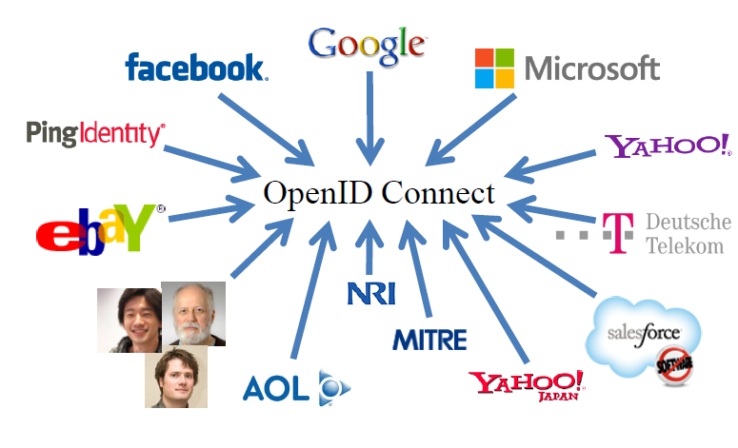
Users Of Open Id Connect

Slide 4
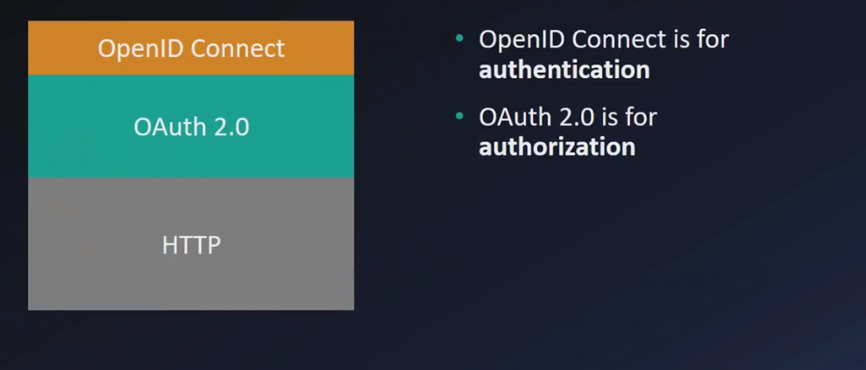
High Level Structure

Slide 5
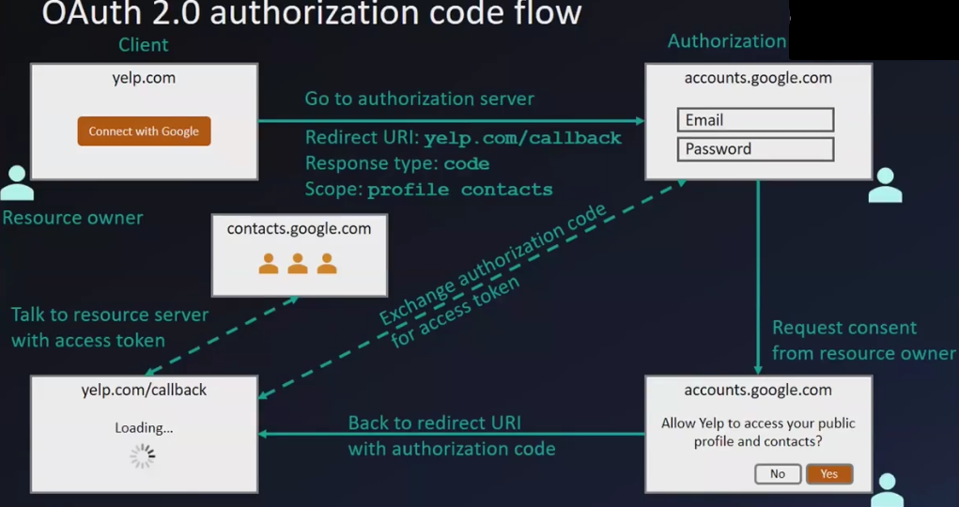
High Level Request Response of OAuth 2.0

Slide 6
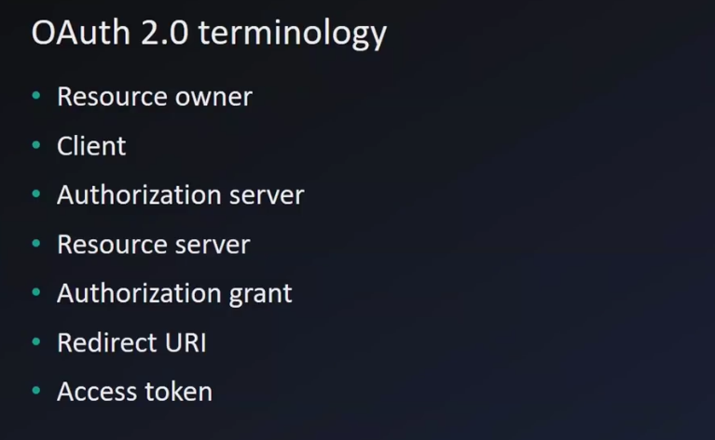
O Auth 2 Terminology

Slide 7
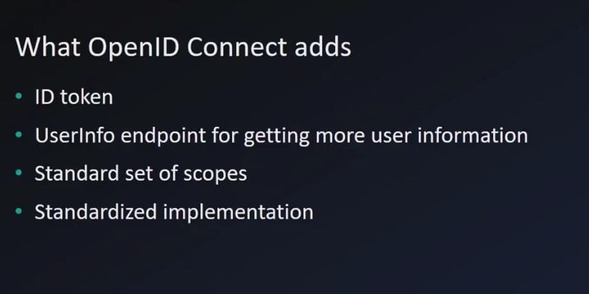
Open Id Connect Addition

Slide 8
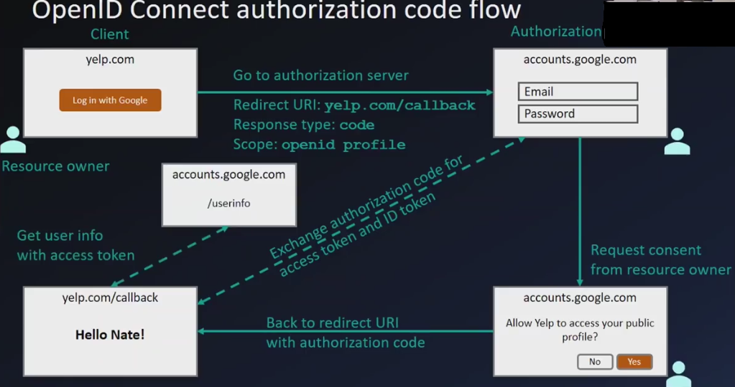
High Level Request Response of Open IdCon

Slide 9
OpenID Connect Intro
Simple identity layer on top of OAuth 2.0
Enables clients to verify identity of end-user
Enables clients to obtain basic profile info
REST/JSON interfaces → low barrier to entry

Slide 10
OpenID Connect Range
•Spans use cases, scenarios
–Internet, Enterprise, Mobile, Cloud
•Spans security & privacy requirements
–From non-sensitive information to highly secure
•Spans sophistication of claims usage
–From basic default claims to specific requested claims to aggregated and distributed claims
•Maximizes simplicity of implementations
–Uses existing IETF specs: OAuth 2.0, JWT, etc.
–Lets you build only the pieces you need

Slide 11
Key Diffs from OpenID 2.0
Support for native client applications
•Identifiers using e-mail address format
•UserInfo endpoint for simple claims about user
•Designed to work well on mobile phones
•Uses JSON/REST, rather than XML
•Support for encryption and higher LOAs
•Support for distributed and aggregated claims
•Support for session management, including logout
•Support for self-issued identity providers

Slide 12
A Look Under the Covers
•ID Token
•Claims Requests
•UserInfo Claims
•Example Protocol Messages

Slide 13
ID Token
JWT representing logged-in session
•Claims:
– iss – Issuer
–sub – Identifier for subject (user)
–aud – Audience for ID Token
–iat – Time token was issued
–exp – Expiration time
–nonce – Mitigates replay attacks

Slide 14
ID Token Claims Example
{
"iss": "https://server.example.com",
"sub": "248289761001",
"aud": "0acf77d4-b486-4c99-bd76-074ed6a64ddf",
"iat": 1311280970,
"exp": 1311281970,
"nonce": "n-0S6_WzA2Mj"
}

Slide 15
Claims Requests
Basic requests made using OAuth scopes:
–openid – Declares request is for OpenID Connect
–profile – Requests default profile info
–email – Requests email address & verification status
–address – Requests postal address
–phone – Requests phone number & verification status
–offline_access – Requests Refresh Token issuance
•Requests for individual claims can be made using JSON “claims” request parameter

Slide 16
UserInfo Claims
sub
name
given_name
family_name
middle_name
nickname
preferred_username
profile
picture
website
gender
birthdate
locale
zoneinfo
updated_at
email
email_verified
phone_number
phone_number_verified
address

Slide 17
UserInfo Claims Example
{
"sub": "248289761001",
"name": "Jane Doe",
"given_name": "Jane",
"family_name": "Doe",
"email": "janedoe@example.com",
"email_verified": true,
"picture": "http://example.com/janedoe/me.jpg"
}

Slide 18
Authorization Request Example
https://server.example.com/authorize
?response_type=token%20id_token
&client_id=0acf77d4-b486-4c99-bd76-074ed6a64ddf
&redirect_uri=https%3A%2F%2Fclient.example.com%2Fcb
&scope=openid%20profile
&state=af0ifjsldkj
&nonce=n-0S6_WzA2Mj

Slide 19
Authorization Response Example
HTTP/1.1 302 Found
Location: https://client.example.com/cb
#access_token=mF_9.B5f-4.1JqM
&token_type=bearer
&id_token=eyJhbGzI1NiJ9.eyJz9Glnw9J.F9-V4IvQ0Z
&expires_in=3600
&state=af0ifjsldkj

Slide 20
UserInfo Request Example
GET /userinfo?schema=openid HTTP/1.1
Host: server.example.com
Authorization: Bearer mF_9.B5f-4.1JqM

Slide 21
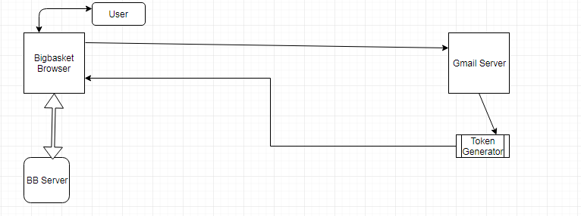
Generic workflow Diag

Slide 22
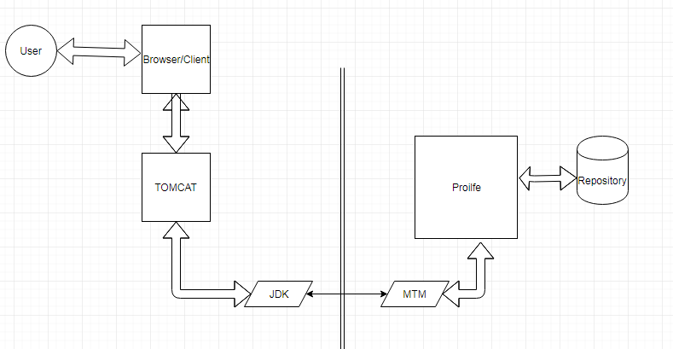
Profile Workflow Diagram

